Slide 1

Python Basics for Data Analysis
Larry Gray, PhD
Data Scientist at KPMG;
Data Science Faculty at Georgetown University
Core Contributor for Yellowbrick.
LinkedIn: https://linkedin.com/in/larry-gray-phd
Github: github.com/lwgray
Email: lwgray@gmail.com
Dr. Larry Gray
Maryland Institute College of Art
October, 18, 2020
See syllabus in Google folder
About the Instructor

Slide 2
Agenda session 1
Installing Software
Python Overview
What is computing?
Explore the Shell
Interactivate Python

Slide 3
Installing Software
Google Folder containing all materials: Use link below to access them
https://drive.google.com/drive/folders/1hMj9foSt9w-QdxQ4K4VBVV3YhWSk72PJ?usp=sharing
First let’s download and install the Anaconda distribution of Python 3.7 for your operating system at
https://www.anaconda.com/distribution
Directions in Google folder! Windows users, please pay attention to the configuration screens!
And the text editor Sublime Text from
https://www.sublimetext.com
Directions (though it is quite easy) are on in Google folder!

Slide 4
then A PEP TALK
You can do it!!!

Slide 5

Be Creative & Have Fun!
Notes:
Before we jump right in, I want to acknowledge that this is going to be quite a 0 to 60 mph class as we’re starting with an assumption of basic working familiarity with your computer, and are going to end up learning most of the applied fundamentals you’ll need to know to start working on data software projects. Not to mention in this field, things are always changing rapidly so there is always something new to learn and it can be hard to keep up. Therefore, I recommend if you are ever feeling down about a bug you’re trying to fix or a concept you’re trying to learn, go to hackertyper.net and start mashing your keyboard and it will look like you are a pro software guru in no time!!!

Slide 6
What Is Computing?
Notes:
First let’s establish what computing really is, and start to understand what your computer is made up of. This will help to demystify some of the concepts we talk about later and take the ‘magic’ out of computing.

Slide 7
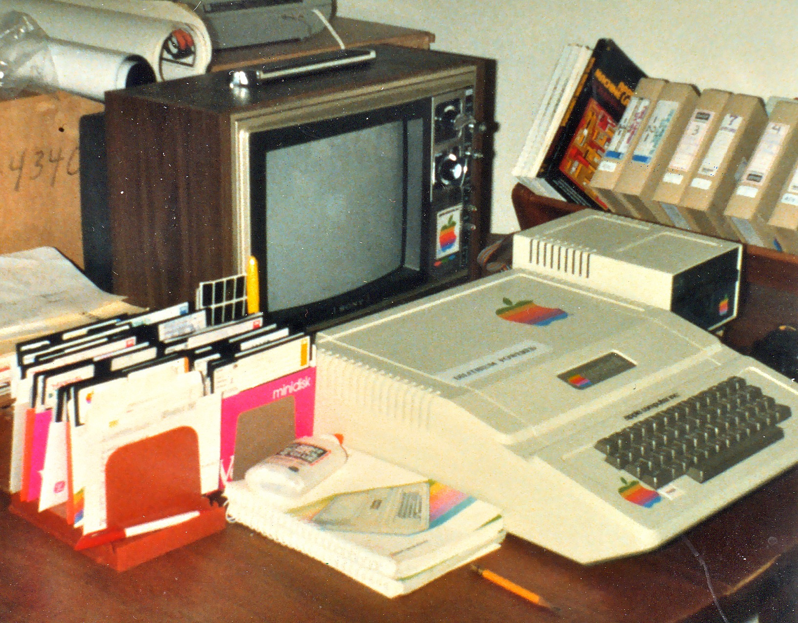
Back to basics
Notes:
Here’s an old-timey computer! Though they look really different now, the underlying concepts are the same. With computation we’re basically just trying to do different types of operations quickly and efficiently on different pieces of data.

Slide 8
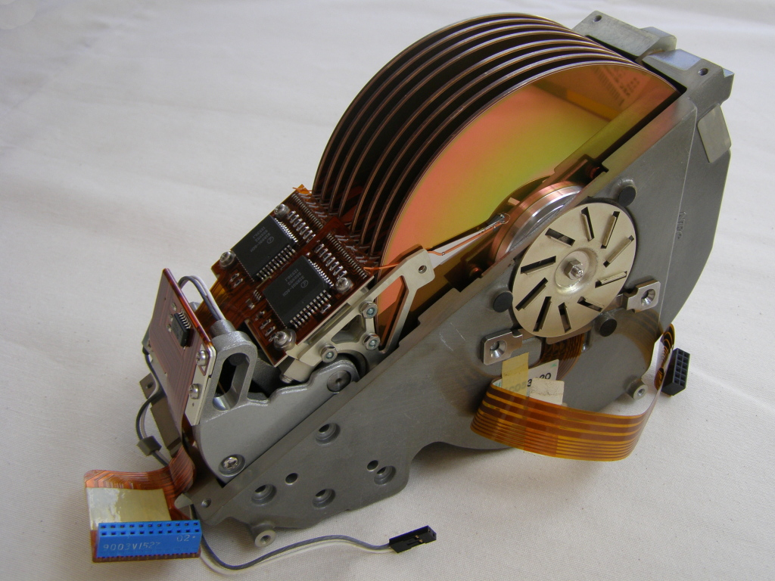
Disk: NEC D5662 Hard disk
Notes:
Here is a hard drive. This is the physical place that your data is stored when you save it to your computer. There are other types of data storage, like USBs or CDs. The simple thing to note here is that when you save data on your computer, it’s just being written somewhere on your storage media so that later operations can access it. When you see people discussing “disk” or “disk I/O”, they’re talking about storing or reading/writing data from this permanent storage location into working memory to be operated on.

Slide 9
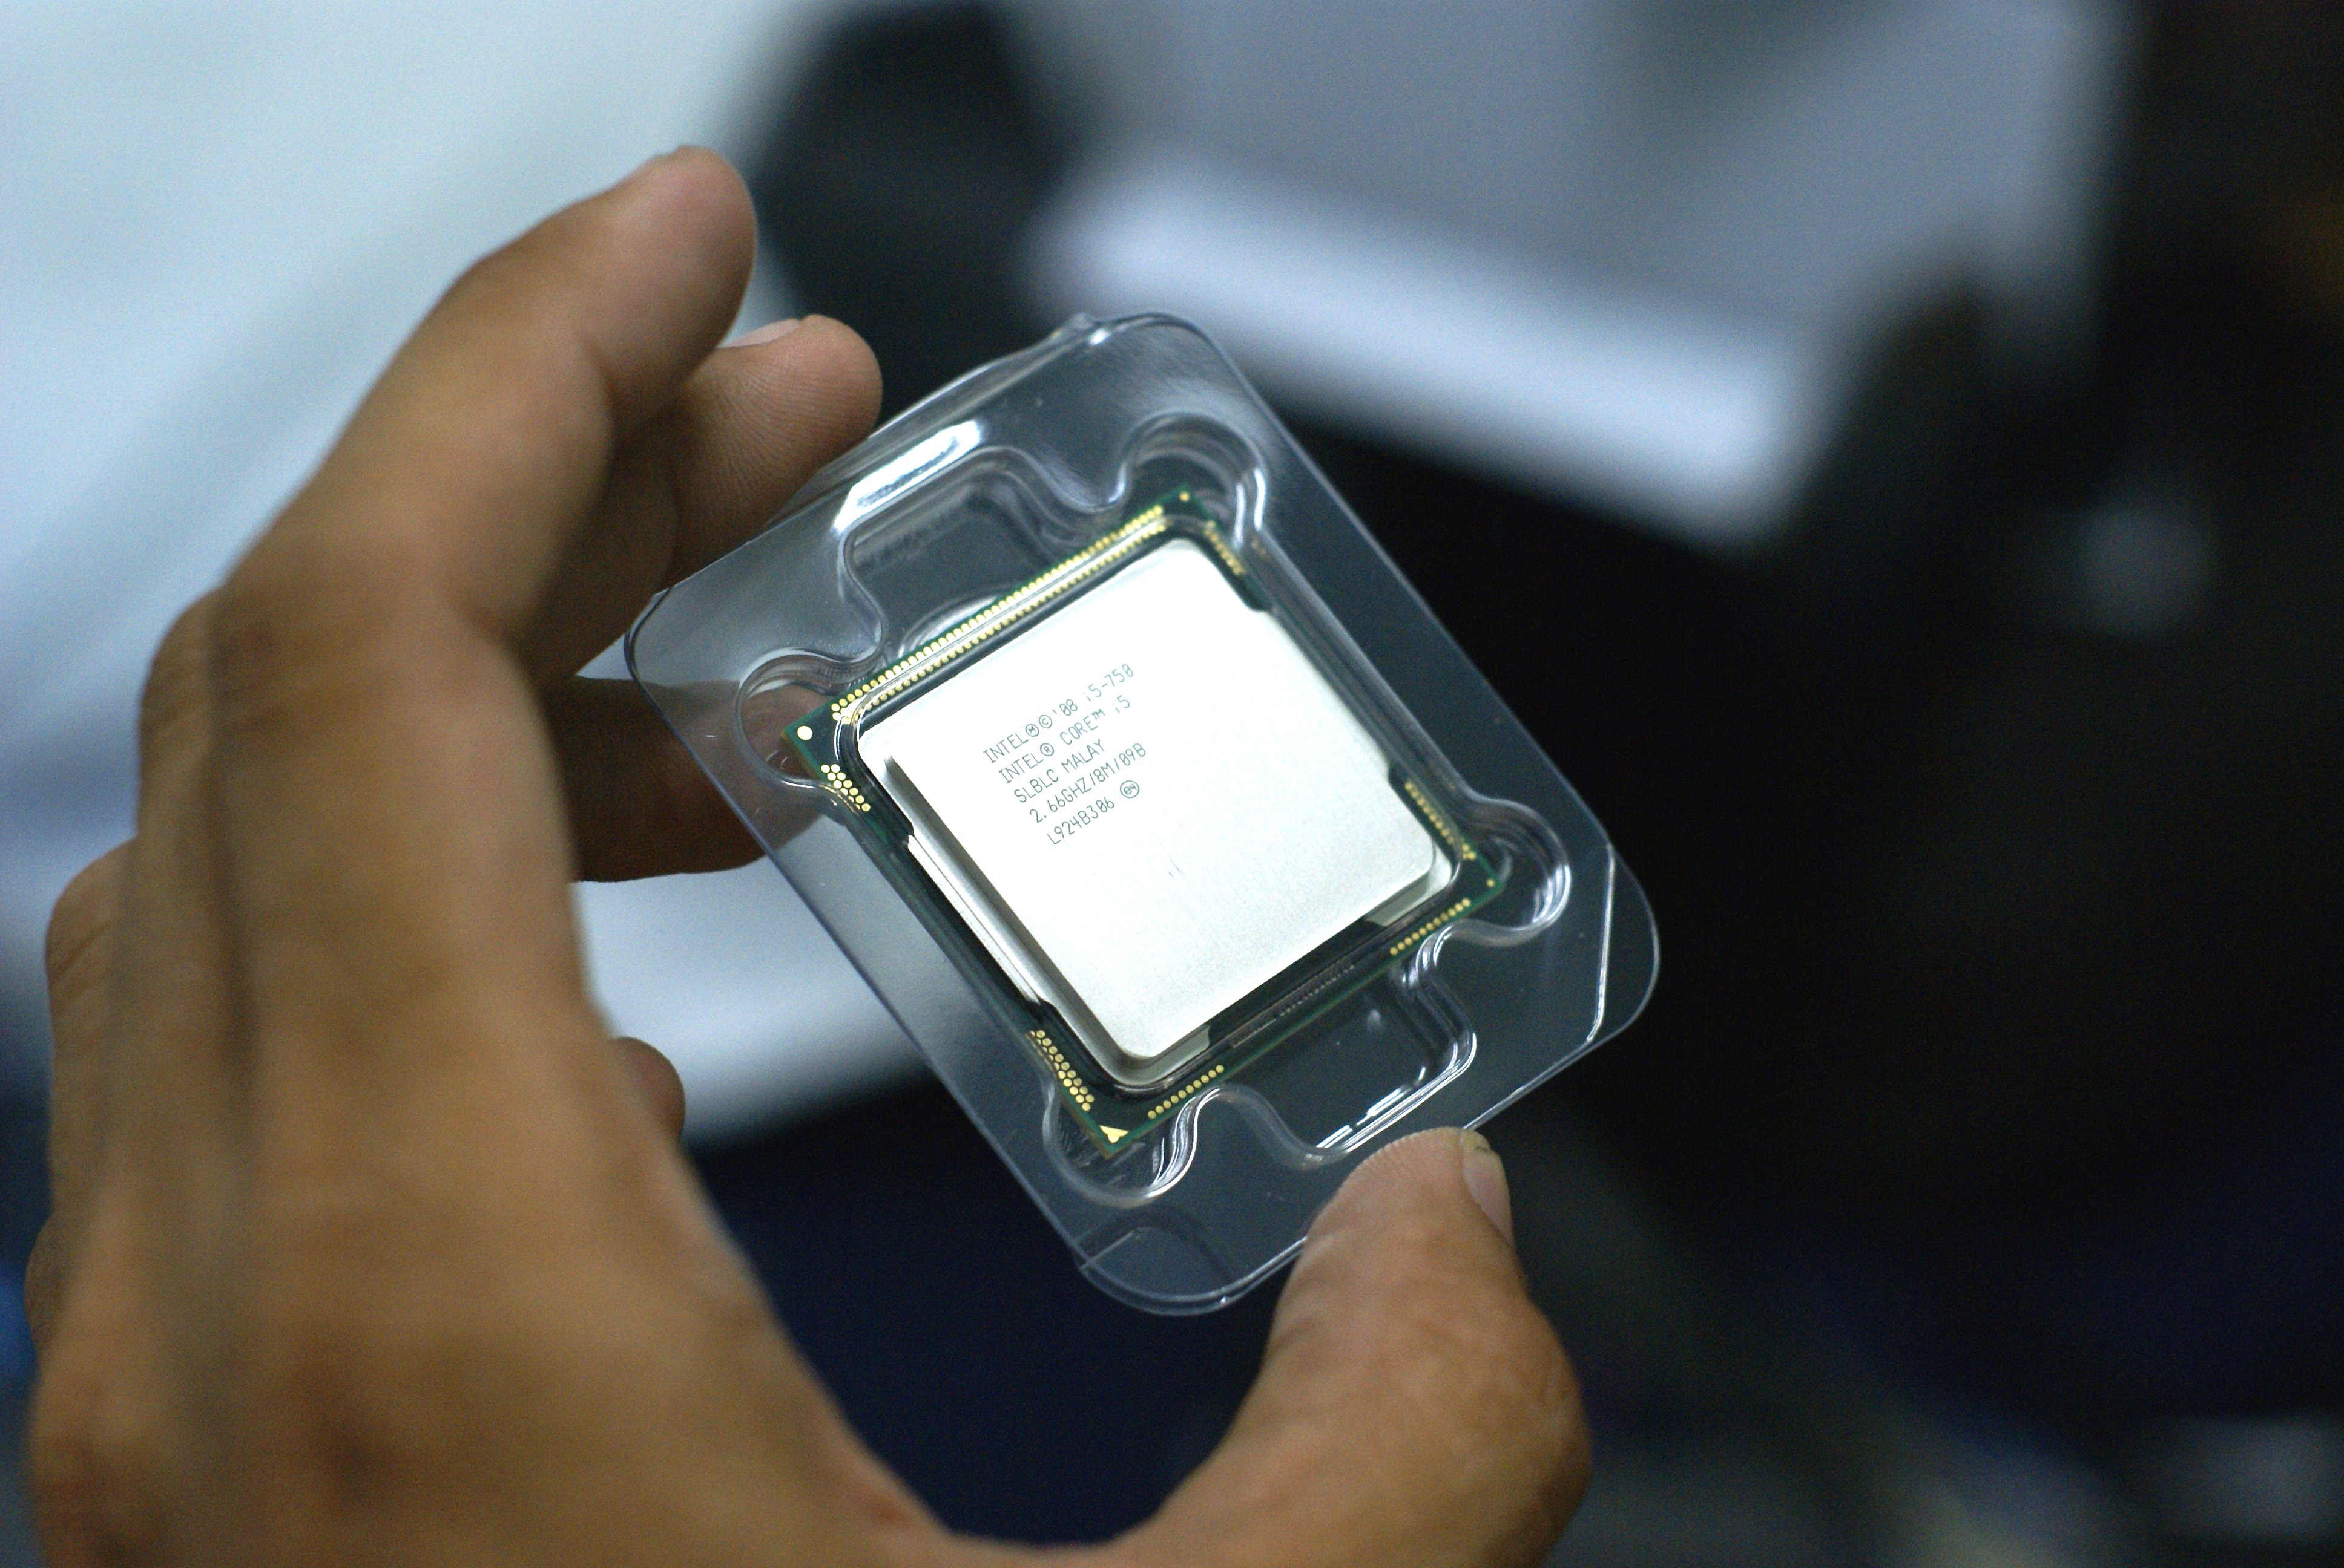
PROCESSOR: Intel Core i5 2.66 GHz
Notes:
Here is a processor. The processor is the physical device that can conduct operations on data it retrieves from the hard disk or other storage device into working memory. When you hear about the term CPU, it’s talking about your processor; when you hear about the term memory or, more precisely, RAM, it’s also talking about the location data is stored while it’s being worked on by the processor.

Slide 10
Computing: So Easy Right?
Disk = Data
Processor = Instructions
Notes:
These two concepts together is really all that your computer knows how to do; store data, and execute operations against it. The hard disk contains the data, and the processor knows how to carry out instructions.

Slide 11
Computing: So Easy Right?
Disk = Data
= Data Types/Classes
Processor = Instructions
= Methods/Functions
Notes:
These ideas map directly to concepts we’ll be talking about when we start talking about writing software. As you write software, you’ll need to access underlying data which is represented as *data types* or *classes*. You’ll also specify operations you can execute against that data, which will be represented by *functions* and *methods*. These terms are going to come up later, and you can always track them back to these basic components of a computer to simplify what is really going on.

Slide 12
Talking To Your Computer
Notes:
Let’s talk about how you normally “talk” to your computer, that is, try to get it to execute instructions on data on your behalf for a specific purpose.

Slide 13
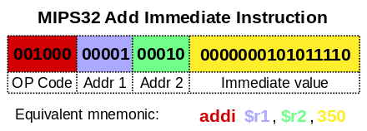
Programming: Instruction Sets/Assembly
Notes:
You may have heard that computer programs are ‘just ones and zeroes”. The simplest, closest-to-computer-language programming language there is are ‘instruction sets’, also called ‘assembly language’. Only very low level programs (low level meaning needing to communicate directly with the hardware of your computer) are written directly with instruction sets or assembly. Most of us don’t want to/need to do this as we are fine interacting with the hardware in some standard way, and over the years ‘higher level’ programming languages have been developed that shortcut some of the things you’d need to encode explicitly with assembly language so it’s easier to write programs that just accept some defaults as to how some of the lower level operations are achieved.

Slide 14
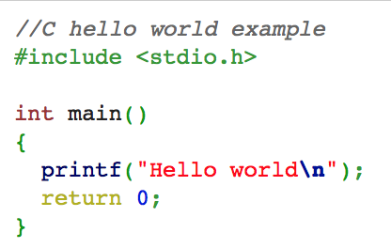
Programming: C
Notes:
One of the earlier and very common ‘higher level’ programming languages is C. C has many derivatives today such as C# or C++, which you also may have heard of. Many programming languages that aren’t exact derivatives of C still borrow many of the concepts or are even written in C underneath. You can see from this example how radically more user friendly C looks compared to assembly language, but C is still relatively low level for our purposes and there are even more languages that have been developed that abstract away more defaults to make programming easier and easier.

Slide 15
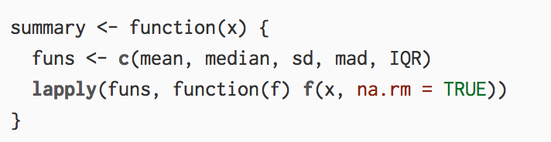
Programming: R
Notes:
Some programming languages are even specialized to a specific type of domain and abstract certain types of operations in such a way that benefit that domain specifically. One programming language some of you might have heard of, that is very commonly used for data analysis, is R. It was specifically developed to aid in data analysis and statistical programming, so some of the things you might have to write custom code to do in other languages, such as read a CSV file, is already included in R out of the box. You can see that this also looks a lot easier to read and understand than assembly language, and is also a little more friendly looking than C. R is primarily developed and used in the academic world and/or by statisticians. It’s often taught for data analysis purposes, but for reasons I’m about to get into, we’ll be learning a different language instead.

Slide 16
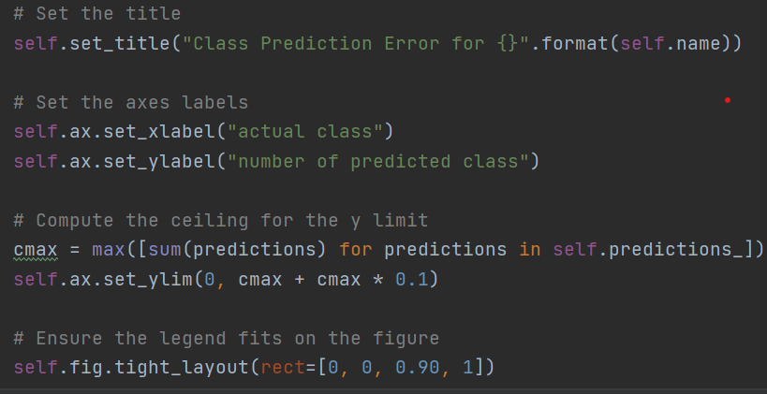
Programming: Python
Notes:
The programming language we’ll be learning for this class is Python. Python is well liked especially as a first language because it is so easy to read, with limited “computery” syntax like brackets or semicolons. However, it’s also well liked because it has powerful data analysis capabilities, some derived directly from concepts in R, while also being good for a number of other purposes such as web development, system administration, or simple scripting.

Slide 17
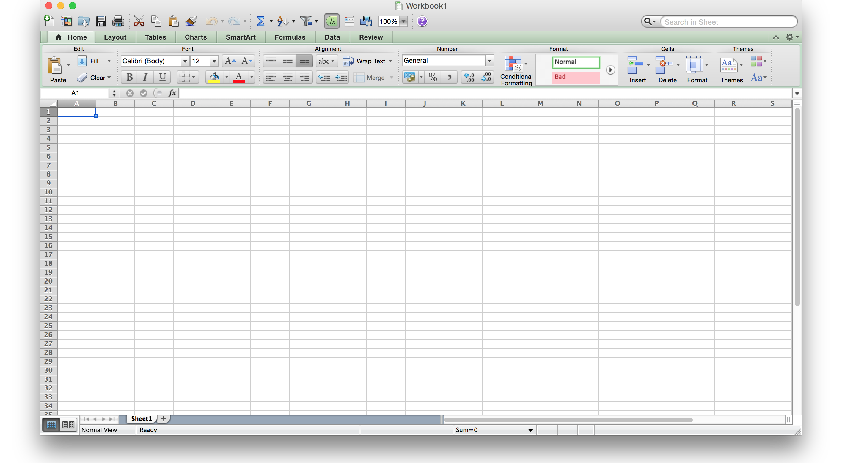
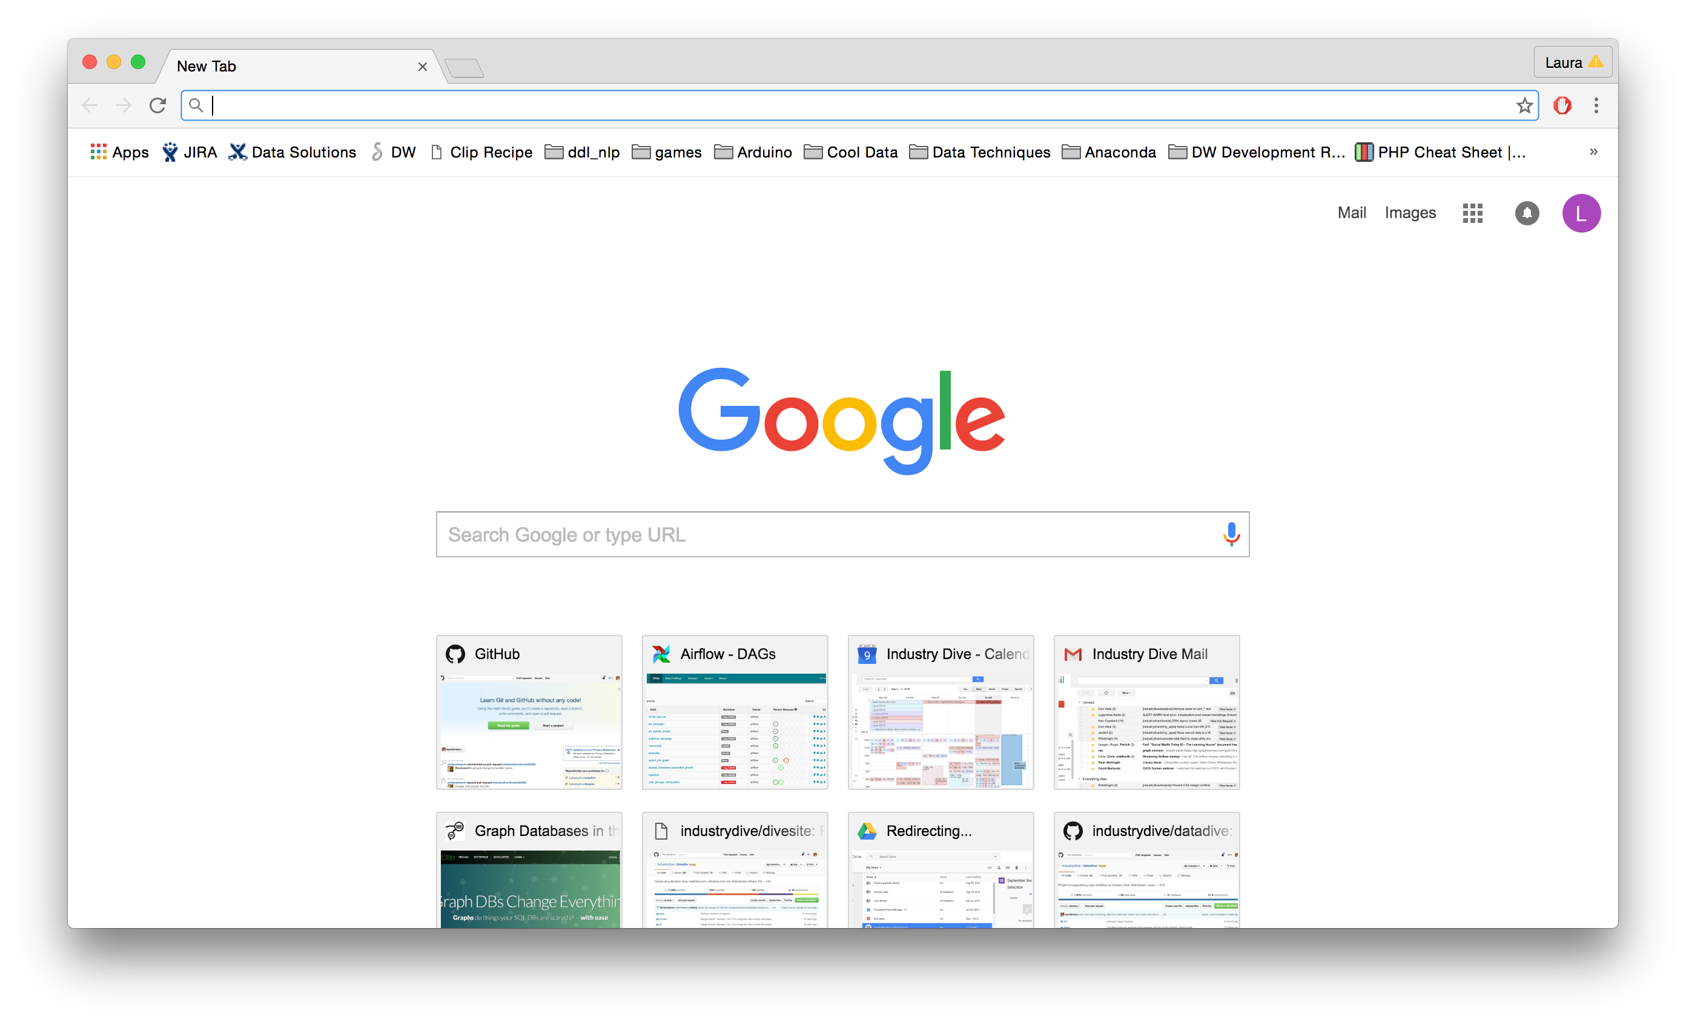
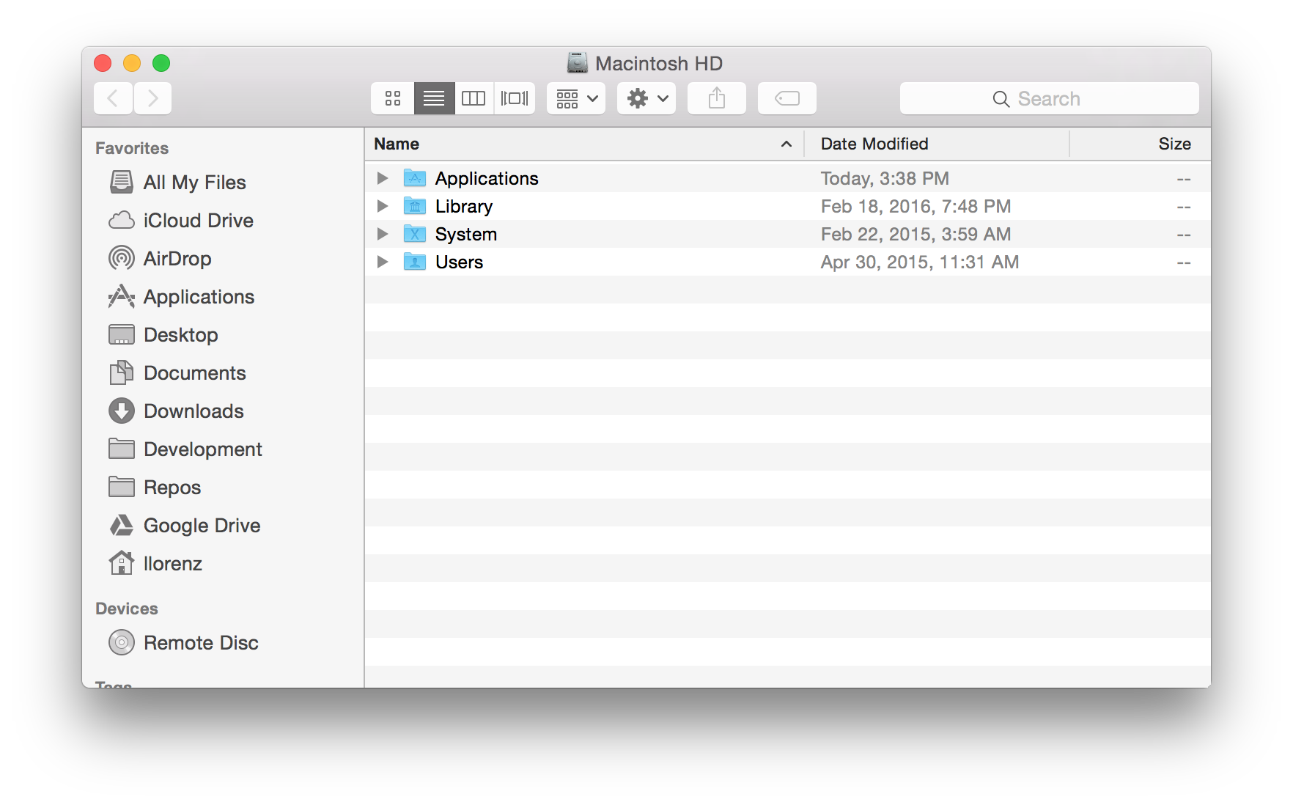
GUIs!
Notes:
GUI stands for Graphical User Interface, and is the way most people are used to interacting with their computer. You’re already used to using some of these programs such as Excel, Chrome, or Finder by interacting with your keyboard and mouse to make different things happen.

Slide 18
Exploring The Shell
Notes:
Let’s figure out how to interact with our computer using our shell program. This is going to be important because not everything we’ll want to do in software development can be achieved through an available GUI.

Slide 19
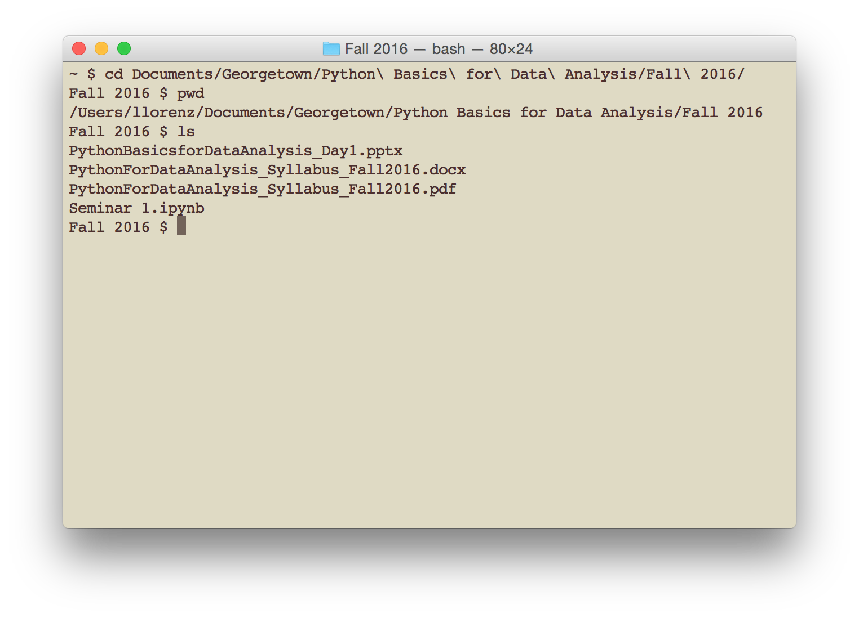
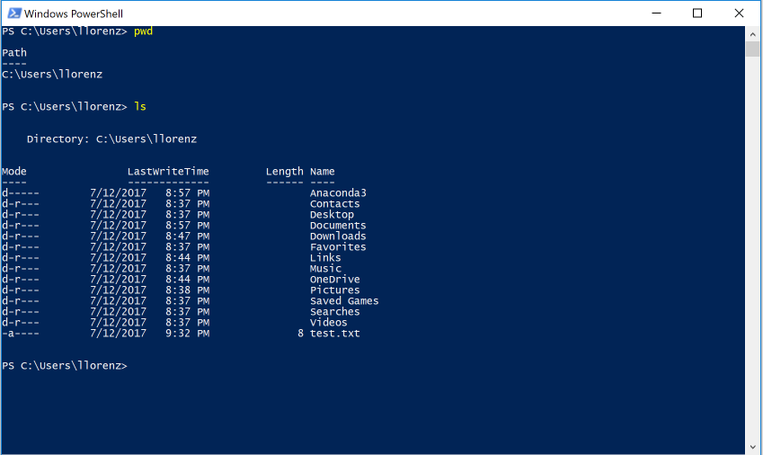
Shell/Command Line/Terminal
Notes:
So these are what we are using: Terminal application on MacOS, and Windows Powershell for anyone using Windows.

Slide 20
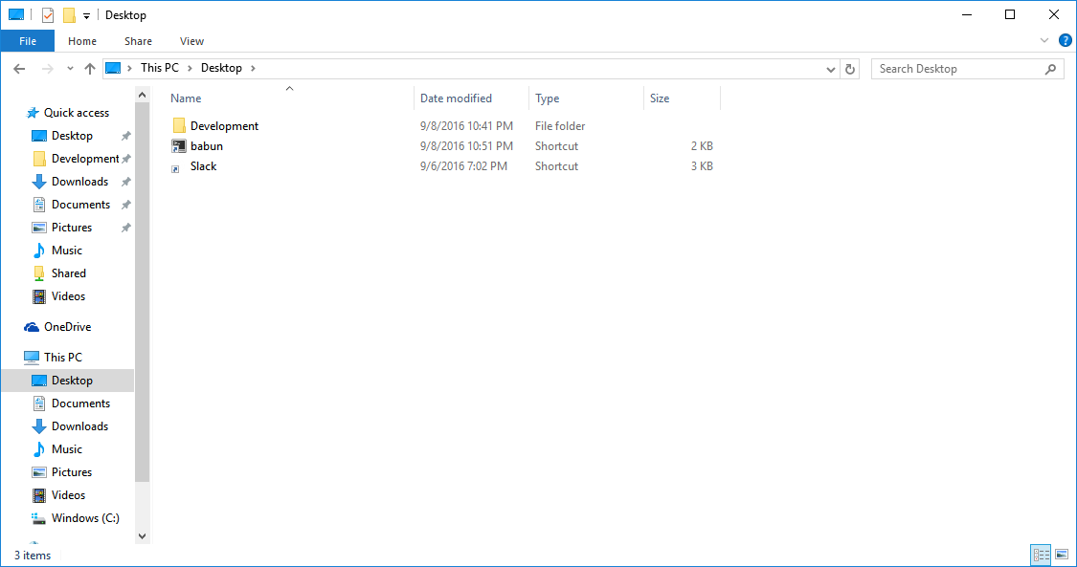
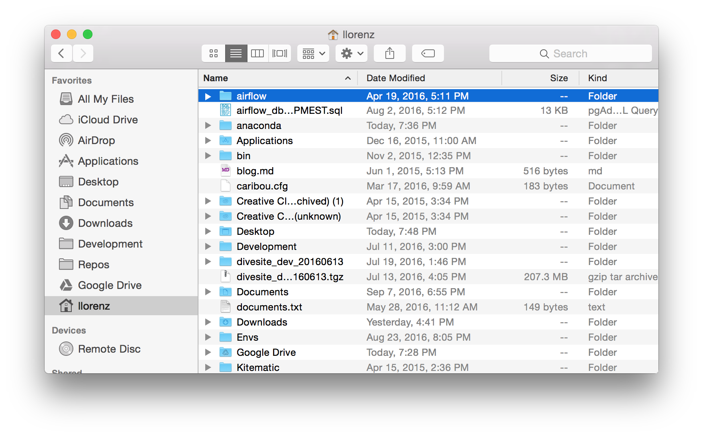
File System Basics
Notes:
You are probably used to interacting with your file system using a GUI like Browser (for Windows users) or Finder (for MacOS users). Normally you point and click to get through to a hierarchy you are interested in, but we’re going to learn how to describe those hierarchies in text so that we can communicate it to our text-only shell applications.

Slide 21
File System Basics
C
Users
lgray
Desktop
Documents
Downloads
Music
Pictures
Videos
Users
lgray
Applications
Desktop
Documents
Downloads
Movies
Music
Pictures
Windows users might recognize:
C:\Users\lwgra\Desktop
MacOS users might recognize:
/Users/lgray/Desktop
Notes:
First off let’s talk about some basics about how your file system is structured. All the files on your hard drive (remember, that’s where all our long term data storage is) is organized into a hierarchical structure determined by your computer’s operating system. For example, the Windows users might recognize “C:\Users\Laura\Desktop” as a *path* that leads to a location on the file system; similarly, MacOS users might recognize /Users/llorenz/Desktop as the same. Any file on your file system can be described by what hierarchical *path* it is located at.

Slide 22

Absolute Paths
Users
lgray
Applications
Desktop
Documents
Downloads
Movies
Music
Pictures
/
C:\
/Users/lgray/Desktop
C:\Users\lgray\Desktop
Notes:
The first type of path we will discuss are ‘absolute paths’. Absolute paths are the fully qualified name of the path to some resource starting from the beginning. It’s like if you were on the Orange metro line at L’Enfant plaza asking how to get to Metro Center, but you explained the whole path starting from the beginning of the Orange line: New Carrolton, Landover, Cheverly, Deanwood, Minnesotta Ave, Stadium/Armory, Potomac Ave, Eastern Market, Capitol South, Federal Center SW, L’Enfant Plaza, Smithsonian, Federal Triangle, Metro Center. In bash and Python, the forward slash represents that everything following it is an absolute path, starting at the very beginning of your file system. Windows users, you’re going to see a lot of backward slashes (\) instead of forward slashes (/) though they will end up being interchangeable for you. But this little Windows ghost here is there to remind you that you may see paths in this format in Windows.

Slide 23
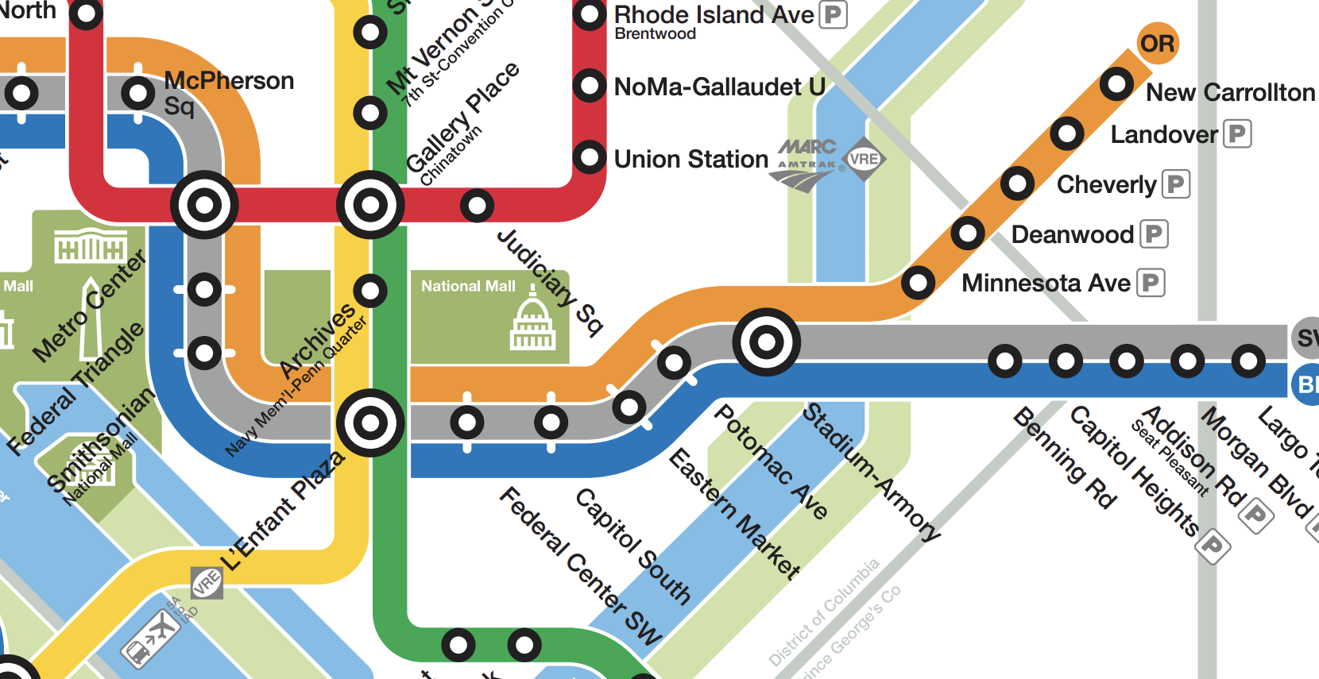


Slide 24
Relative Paths
Users
lgray
Applications
Desktop
Documents
Downloads
Movies
Music
Pictures
Desktop
Notes:
Relative paths on the other hand, take into account where you currently ‘are’ in the file system and describe the way to get to some file in terms relative to the current location. In this case, if you were at L’Enfant Plaza explaining the stops to Metro Center, you could just say: Smithsonian, Federal Triangle, Metro Center.

Slide 26
Relative Paths
Users
lgray
Applications
Desktop
Documents
Downloads
Movies
Music
Pictures
.
Desktop
./Desktop
.\Desktop
Notes:
In the shell and in Python, your current location is represented by a single period. So, given you are currently located in the ‘llorenz’ directory, these two ways of describing the ‘Desktop’ directory are equivalent.

Slide 27
Relative Paths
Users
lgray
Applications
Desktop
Documents
Downloads
Movies
Music
Pictures
..
Desktop
./Desktop
../lwgra/Desktop
\
Notes:
Another shortcut is two periods, which represents the directory directly above your current position. So, in a roundabout way, you can still describe the ‘Desktop’ directory using two periods by reestablishing the rest of the path from one up of our current directory, ‘llorenz’.

Slide 28
Relative Paths
Users
lgray
Applications
Desktop
Documents
Downloads
Movies
Music
Pictures

~ is a concept specific to your terminal program.
Terminal default:
/Users/lgray
Powershell default:
C:\Users\lgray
~
“home”
Desktop
./Desktop
~/Desktop
Notes:
There is another shortcut that is useful that your ‘home’ directory, which is represented in your shell by a tilde. This is specific to your terminal program; you can see the common defaults per terminal in the gray box.

Slide 29
Shell/Command Line/Terminal
Notes:
So these are what we are using: Terminal application on MacOS, and Windows Powershell for anyone using Windows.

Slide 30
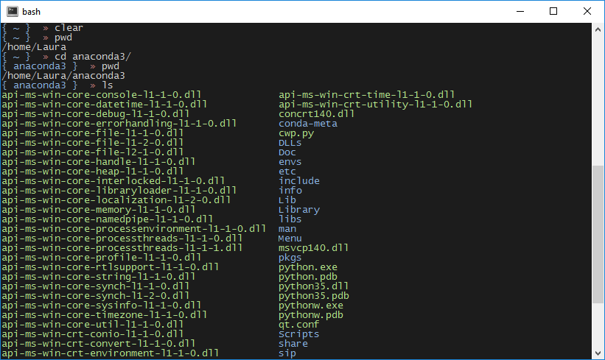
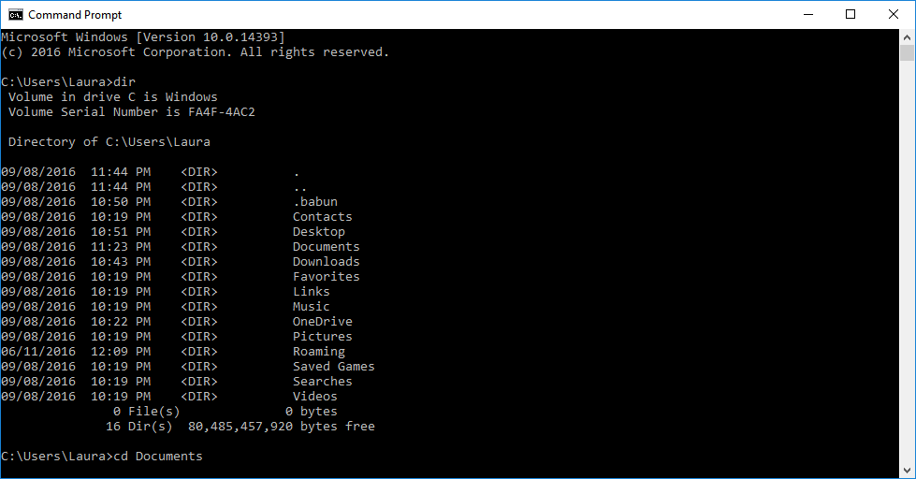
Shell/Command Line/Terminal
Notes:
In fact, there are many other shell programs. I’ve included two other shell programs for Windows operating systems, Command Prompt and babun. Command prompt comes standard on Windows machines and is actually the default; babun is a third-party application available for free download online, and is technically a version of another shell called “Cygwin”.

Slide 31
Shell/Command Line/Terminal
bash
bash
DOS
PowerShell
Notes:
Different shell applications use different language syntax. The default Windows command line program, cmd.exe, uses DOS syntax. Another pre-installed Windows command line program, PowerShell, uses its own command line syntax that is closer to bash. In previous iterations of this course I had Windows users install a program called Babun that runs fully-featured bash in Windows so I only taught one type of syntax. This time, we’re going to try teaching both types of syntax so we will be learning both Bash and PowerShell. Unfortunately (for Windows users) Bash is far superior and all the Windows users will probably want to switch over to it at some point in the future, but for a beginner it may turn out to be easier to start with the OS’ standard shell language.

Slide 32
Shell/Command Line/Terminal
Notes:
So these are what we are using: Terminal application on MacOS, and Windows Powershell for anyone using Windows.

Slide 33
Shell/Command Line/Terminal
Mac Users:
~/Applications/Utilities/Terminal
Windows Users:
Start > Windows PowerShell > Widows PowerShell
Notes:
MacOS users, I can pretty much guarantee you will find your terminal program at this location; you can navigate to this application with your finder. I suggest pulling it down into your Dock since you’ll be using it a lot! Windows users, you can search with your Search bar (or Cortana) or if you navigate with the Start menu, it should be at this location (particularly if you are using Windows 10, which is what I tested this with). You also might like to pin this to your taskbar.
Now, let’s get started actually using the shell!!!

Slide 34
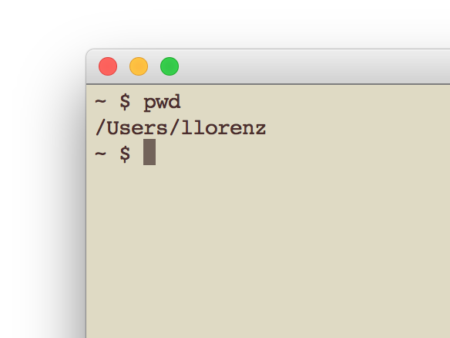
Shell/Command Line/Terminal
pwd
“present working directory”
or,
“WHERE AM I RIGHT NOW?”
Notes:
Shell commands are executed by typing some text (preferably not just any text but some valid shell commands, if you want to avoid an error), and pressing enter. Your terminal program can be configured many different ways, but the default configuration for Terminal generally preceeds where you type with a dollar sign $, or in Powershell the characters PS, so you know that you are on an active line. Any output from a command you specify will be shown after it executes on the line below it, without the $. That $ or PS is called a PROMPT.

Slide 35
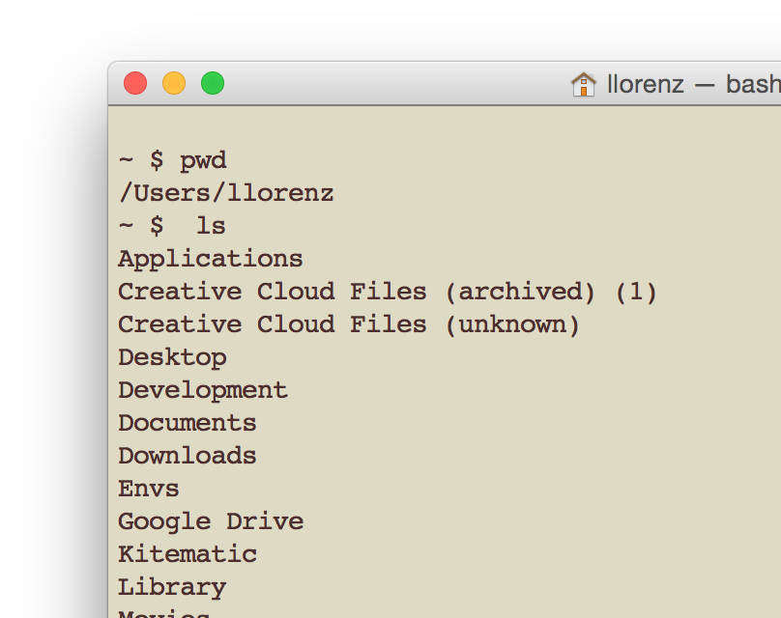
Shell/Command Line/Terminal
ls
“list directory contents”
or,
“what is even in here??”

Slide 36
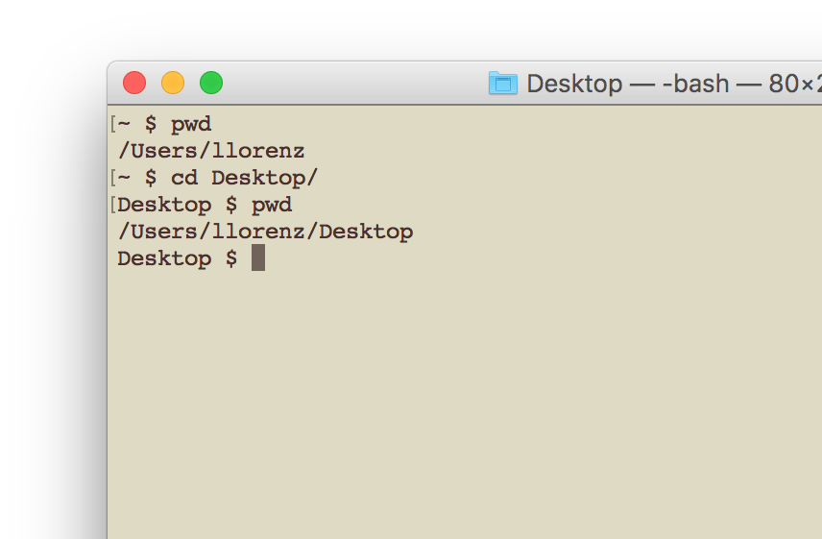
Shell/Command Line/Terminal
cd
“change directory”
or,
“get me somewhere else!”
Relative path!!

Slide 37
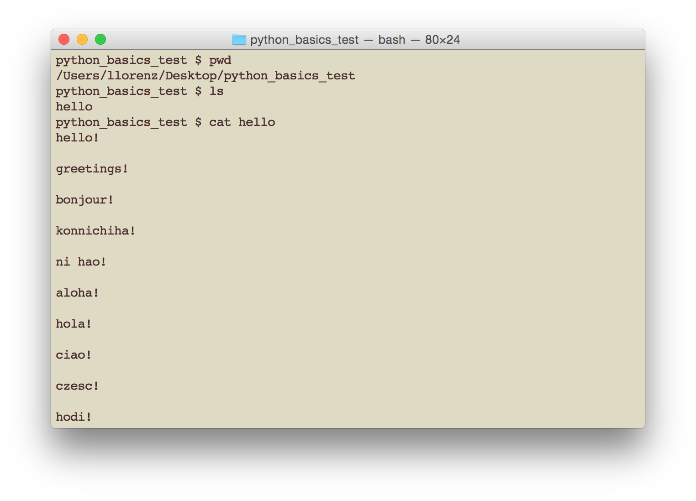
Shell/Command Line/Terminal
Bonus! You can ‘redirect’ output
into another file with >, e.g.
cat hello > hello2
cat
“concatenate and print files”
or,
“print out all the contents of this/these file/files to my terminal screen”

Slide 38
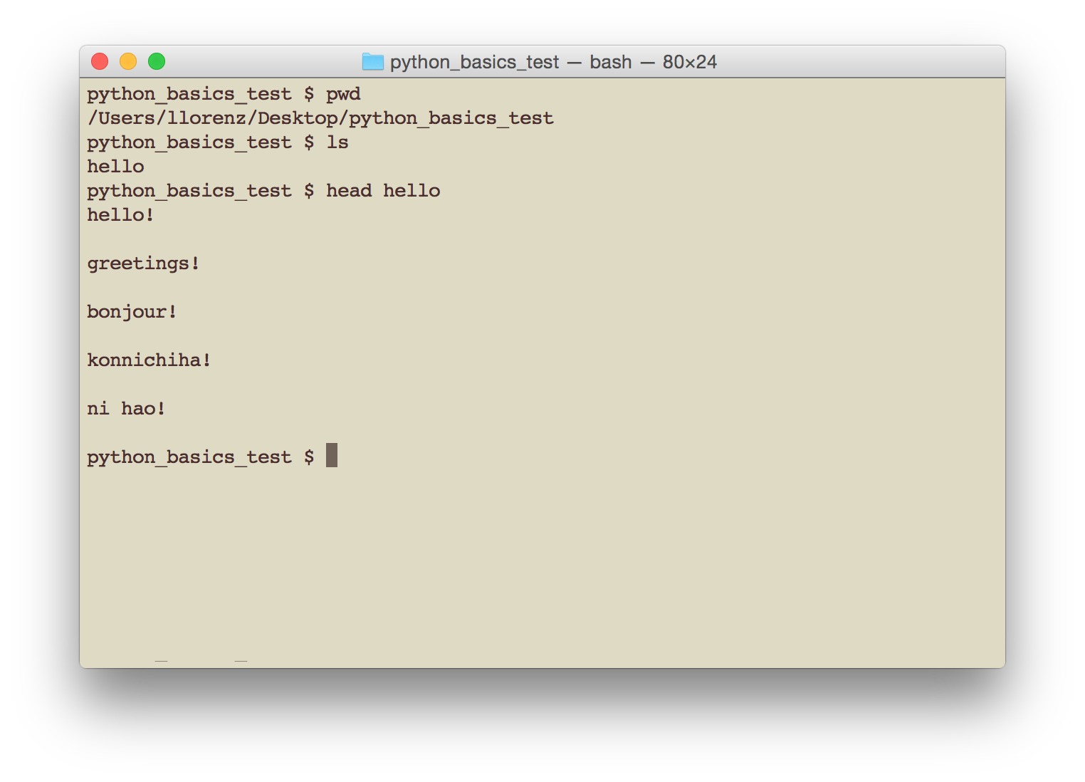
Shell/Command Line/Terminal
head
“display first lines of a file”
cat filename –first 10

Slide 39
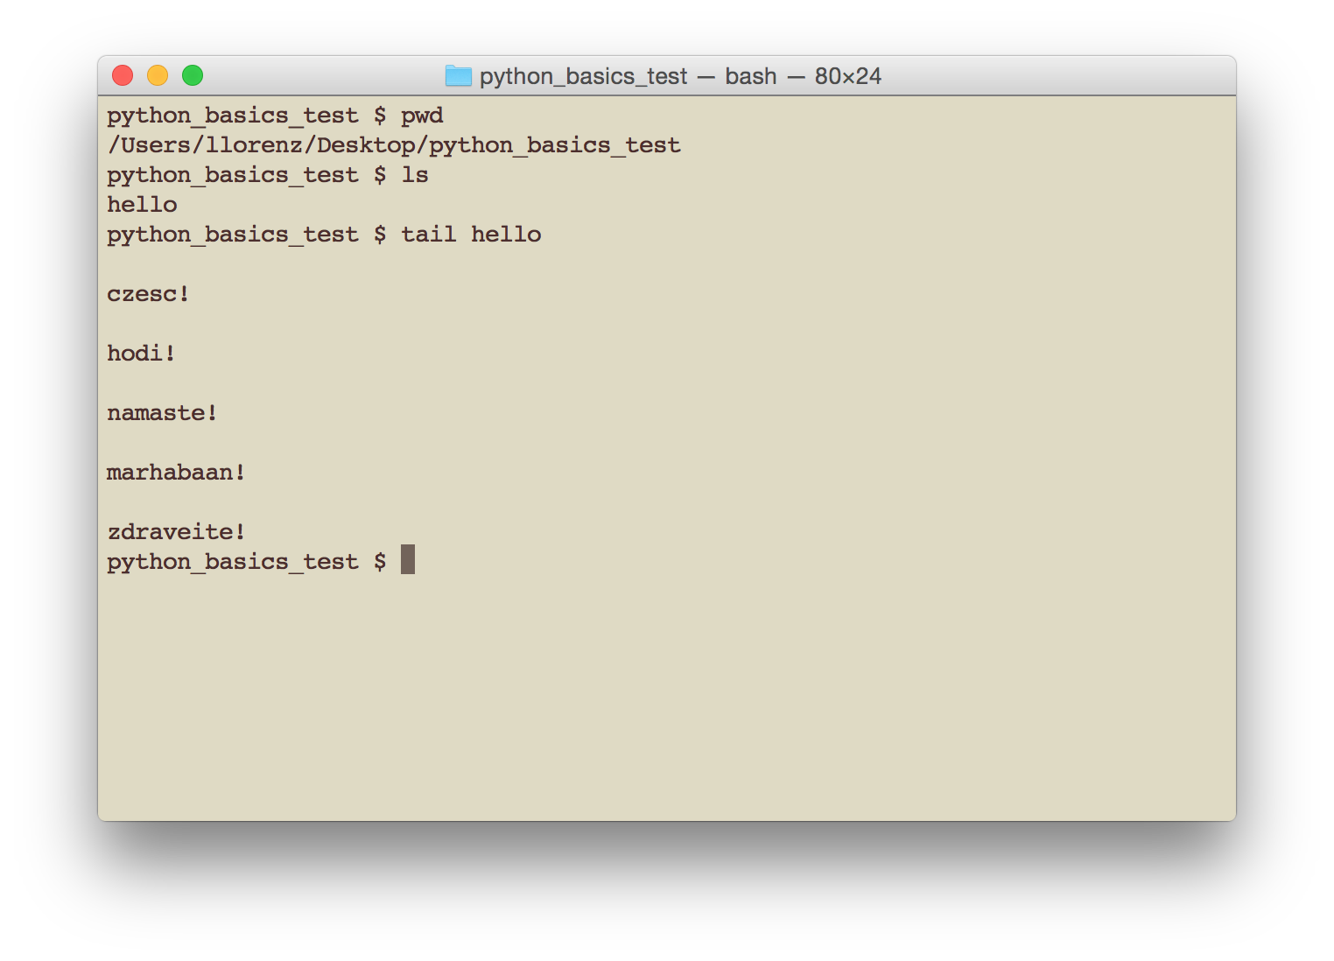
Shell/Command Line/Terminal
tail
“display the last part of a file”
cat filename –last 10

Slide 40
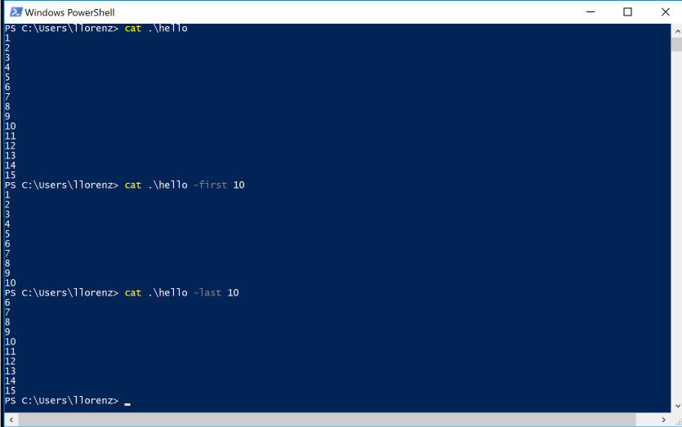
cat/head/tail example

Slide 41
EXPLORING Python

Slide 42
Running Python interactively from the command line
If you installed on MacOS, or on Windows having selected to add Anaconda to your PATH, just type python
Otherwise…
Notes:
To run Python you will need to specify either the absolute or relative path to the PYTHON EXECUTABLE. Here are some likely paths, though it depends on where you told anaconda to install Python during installation. We will take a break at this point, but before we do I want to make sure everyone’s installation is right and they can get into the Python interpreter from their terminal program.
Once Python is running interactively in your terminal, you will see instead of the normal bash prompt $, a new prompt that looks like >>>. This means that the Python interpreter is running and the terminal program is expecting Python commands, NOT bash commands. Always check your prompt!!

Slide 43
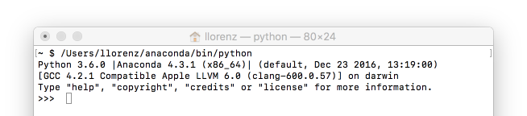
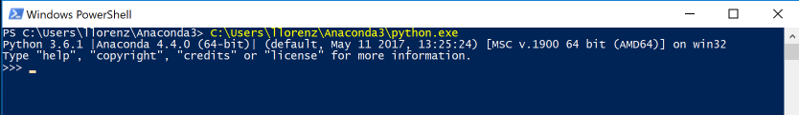
Running Python interactively from the command line
If you installed on MacOS, or on Windows having selected to add Anaconda to your PATH, just type python
Remember to use the path where YOU installed Anaconda!
It may be different from mine!
Notes:
To run Python you will need to specify either the absolute or relative path to the PYTHON EXECUTABLE. Here are some likely paths, though it depends on where you told anaconda to install Python during installation. We will take a break at this point, but before we do I want to make sure everyone’s installation is right and they can get into the Python interpreter from their terminal program.
Once Python is running interactively in your terminal, you will see instead of the normal bash prompt $, a new prompt that looks like >>>. This means that the Python interpreter is running and the terminal program is expecting Python commands, NOT bash commands. Always check your prompt!!

